Slide 1
How to use PHP with a MySQL Database
Connect to a DB
SELECT Queries

Slide 2
Objectives
Overview of connection options
Connecting with MYSQLI
Create a database configuration file
Execute SELECT statements
Fetching and displaying results
Testing with Contacts database

Slide 3
How to connect to a MySQL DB
Mysql was the traditional way to communicate with MySQL (deprecated)
mysqli in PHP 5 added new features
object-oriented interfaces
support for prepared statements
more secure – cuts down on injection attacks
ability to process multiple statements at a time rather than one by one
support for transactions

Slide 4
Getting a Connection
Need:
Database (setup by your ISP or by you if you have permission)
Hostname often just localhost yourDomain.imagreatstudent.com
UserName
Password

Slide 5
Create a Configuration File
You should have one place to go for the connection information.
Makes it easy to refer to a single file.
If you need to change a username or password – it’s in one place rather than every file that connects to the database.
Create a new php file ‘dbinfo.php’

Slide 6
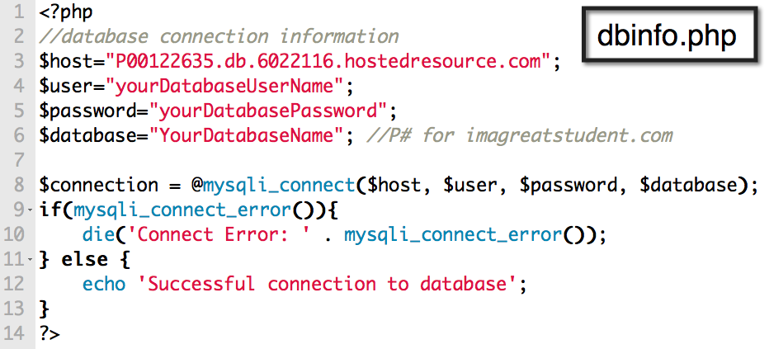
If there is an error with the connection, the error is put in the mysqli_connect_error property.
The @ before the new suppressed the normal error handling. Without @ it displays the regular, less user-friendly errors.
Try uploading to your server and test by going to the dbinfo.php page.

Slide 7

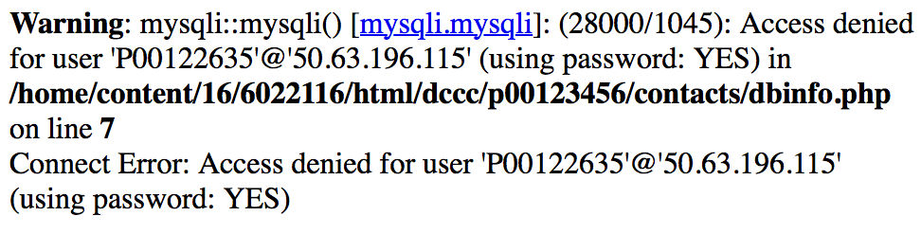
With the @ suppression
Without the @ suppression

Slide 8
mysqli_query()
mysqli_query(database-connection, sql-query);
You pass it a MySQL statement and it returns a result set, or true if successful, false if it fails.
The MySQL command to see a list of tables is SHOW_TABLES.

Slide 9
mysqli_query functions
mysqli_num_rows contains the number of rows
mysqli_fetch_array() returns the results as an array for each record. In this case, each table.
The first element in the array contains the table name.

Slide 10
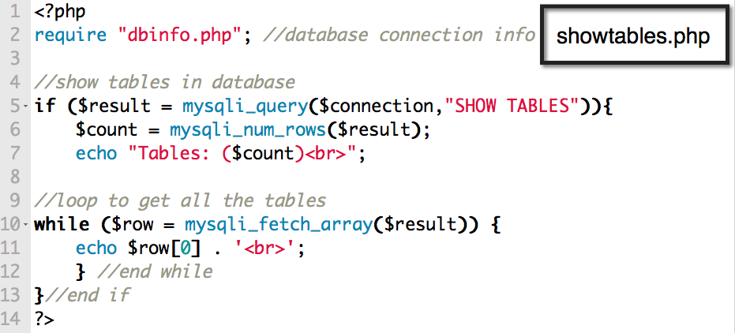
Create a new php file

Slide 11
Selecting Data
Purpose: retrieve data from the database.
The SELECT command is most common SQL command.
We will work with single tables.

Slide 12
Selecting Data in PHP
Make a connection to the database.
Create a safe query.
Use it as the right side of an assignment.
Run the query.
Read the results.

Slide 13
mysqli_fetch_array()
Returns one row of data at a time, in an array format.
You will almost always want to use a while loop to fetch the results from a select query.
Can add an optional second paramter to specify what type of array is returned:
associative
indexed
both

Slide 14
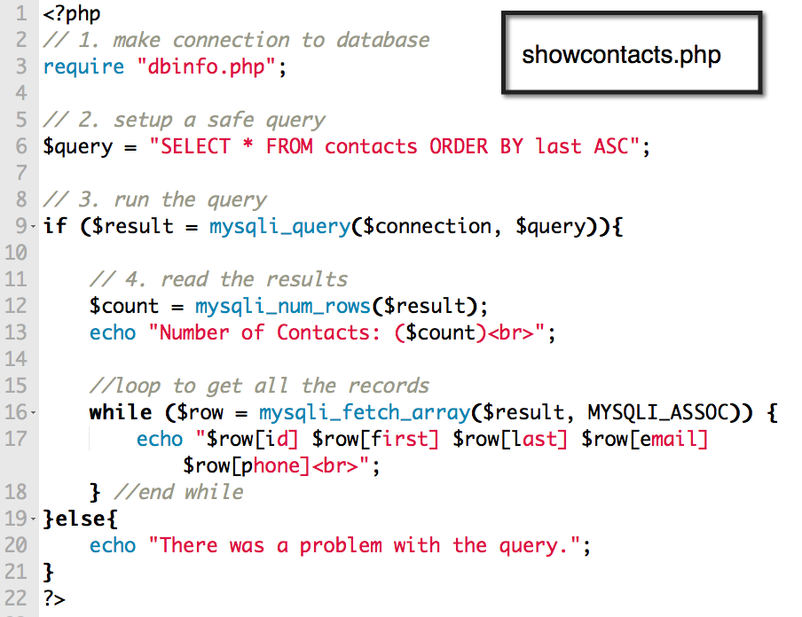
Create new php file

Slide 15
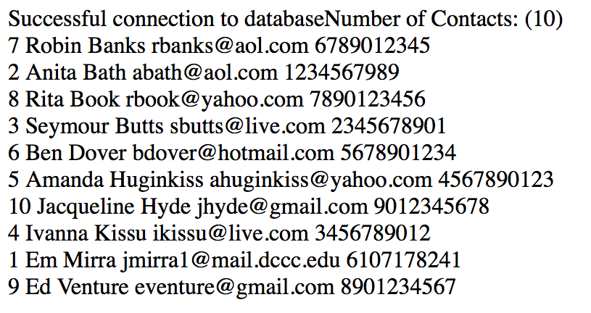

Slide 16
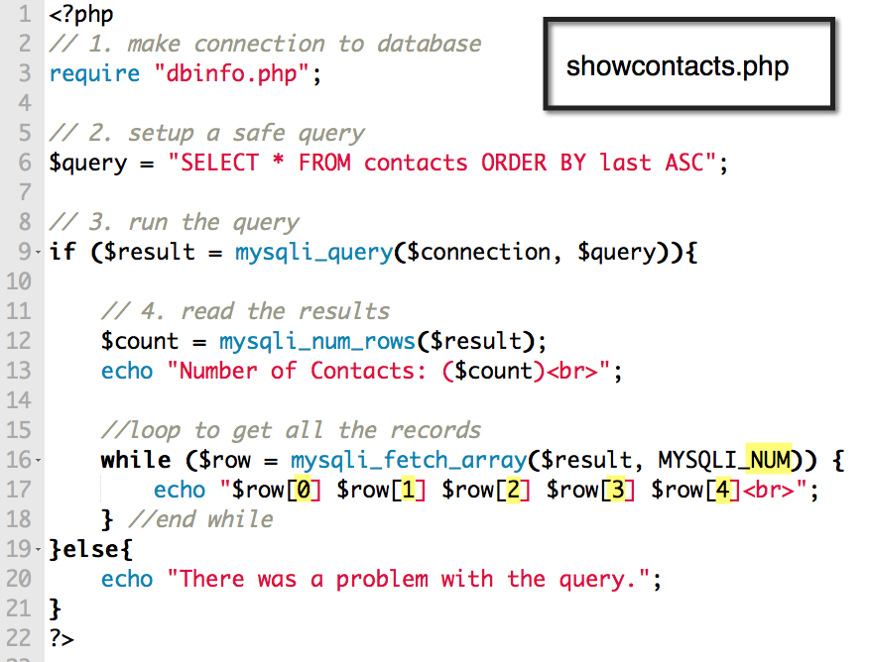

Slide 17
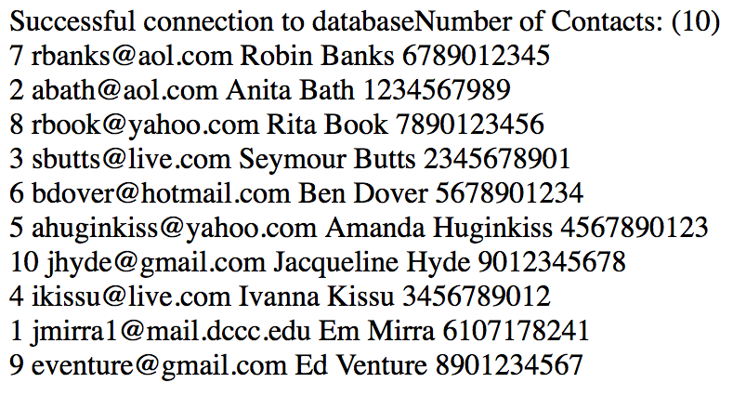
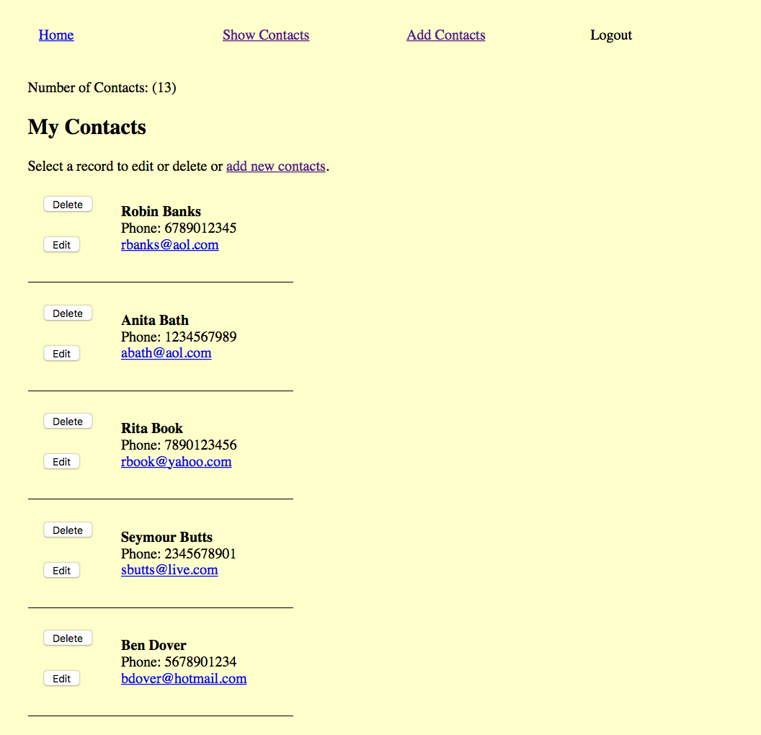

Slide 19
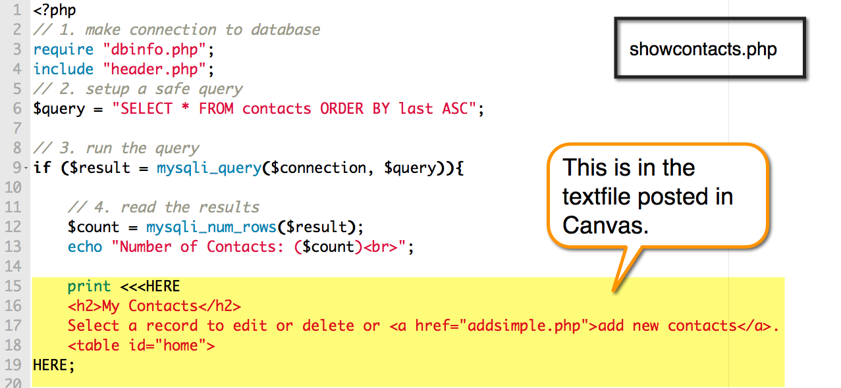

Slide 20
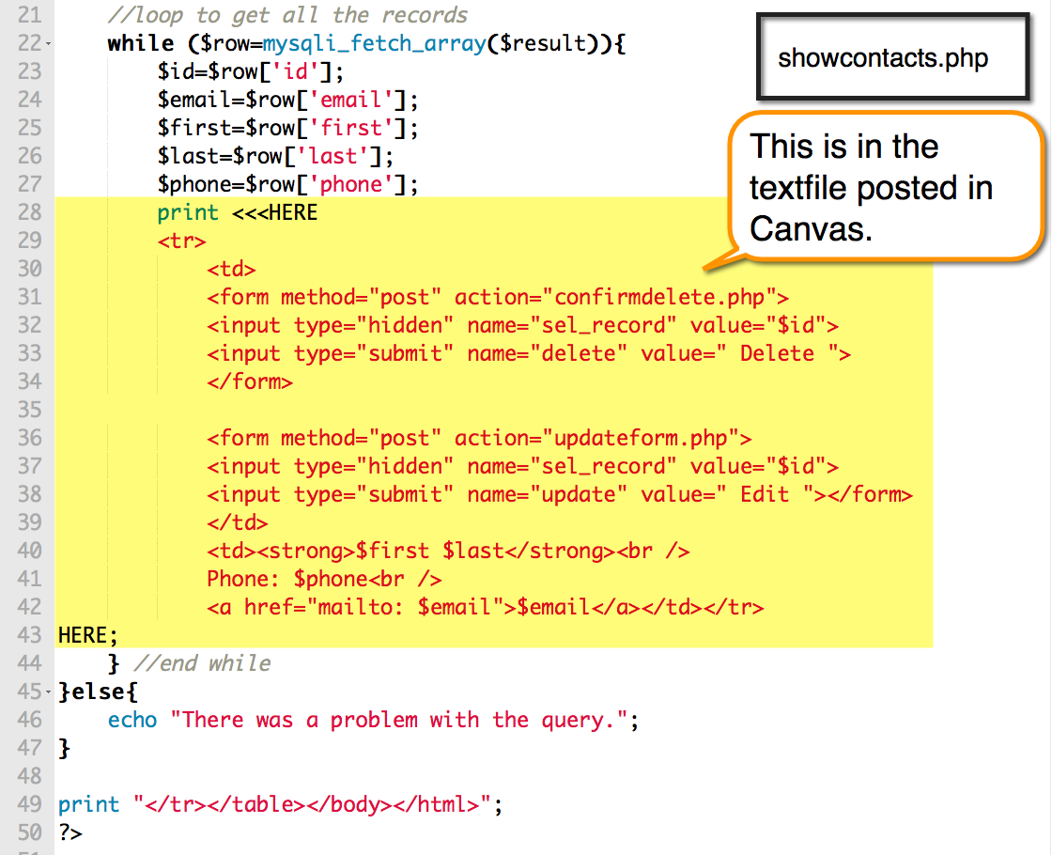

Slide 21
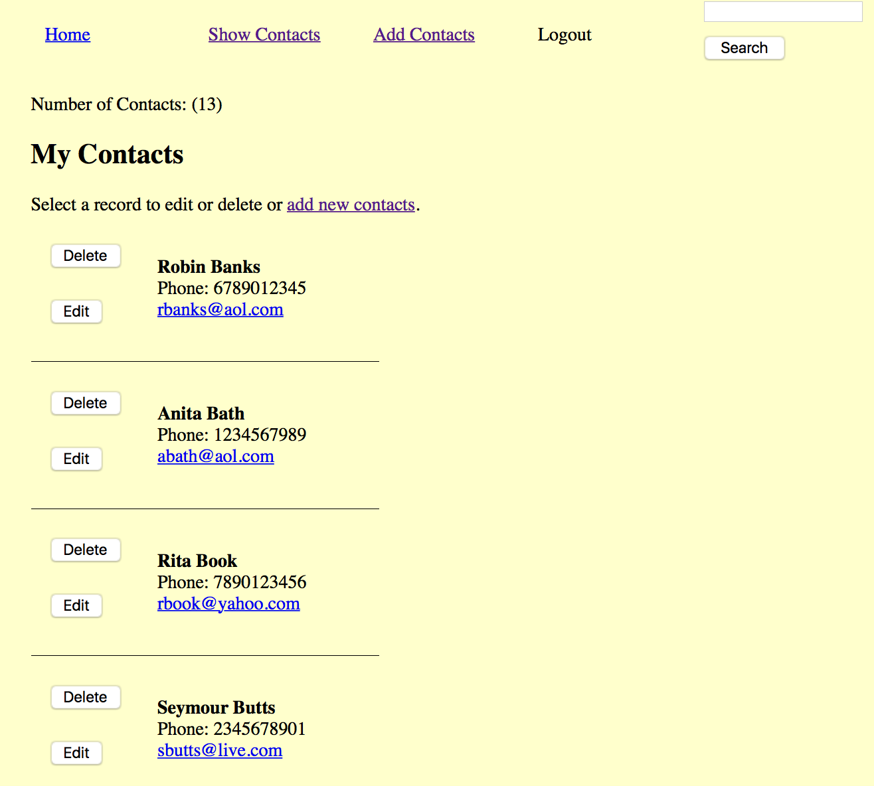

Slide 22
SCRUD Lab
Search
Create
Read
Update
Delete
See if you can connect to your Aliens Database and display the record(s) in your table.
This is the Read component of the lab.

